Slide 1


Delivery Route Optimizer with Real-Time Constraints
Azure Databricks-Based Smart Logistics System

Slide 2
Problem Statement
Traffic congestion
Delivery deadlines
Multiple delivery locations
Vehicle limitations
Static routing causes delays and inefficiency

Slide 3
Project Objective
Build
Build real-time delivery optimization
Assign
Assign packages efficiently
Minimize
Minimize travel time
Prioritize
Prioritize urgent deliveries

Slide 4
Proposed Solution
Dynamic route optimization system
Uses real-time traffic data
Priority-based delivery
Optimized routes generation

Slide 5
Technologies Used
Azure Databricks
Apache Spark
Python
Google Maps API
Plotly

Slide 6
System Architecture
Input Delivery Data
Spark Processing
Priority Classification
Real-Time Distance Calculation
Route Optimization
Vehicle Assignment

Slide 7

Data Model
Location (Lat, Lon)
Priority Level
Weight
Volume
Delivery Time Window

Slide 8
Delivery Priority Levels
Express – Urgent
Standard – Normal
Economy – Flexible

Slide 9
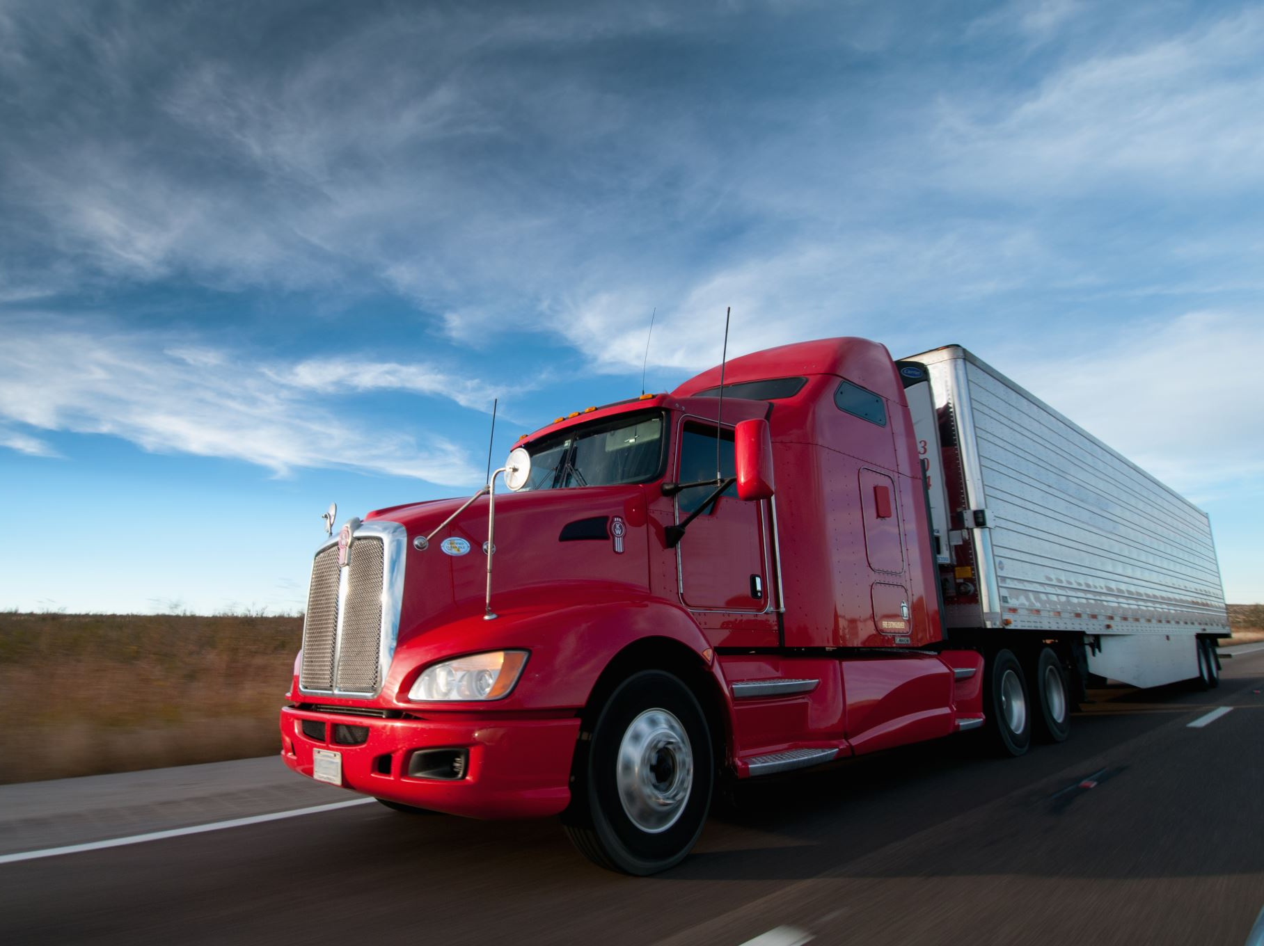
Vehicle Types
Cars
Trucks
Vans
Motorcycles

Slide 10
Real-Time Intelligence
Actual road distance
Traffic-aware ETA
Travel time estimation

Slide 11
Optimization Logic
Group by priority
Calculate travel time
Assign deliveries
Generate delivery sequence

Slide 12
Role of Azure Databricks
Handles large data
Distributed computation
API integration
Scalable solution

Slide 13
System Output
Optimized routes
Vehicle assignments
Priority scheduling
Reduced delays

Slide 14
Benefits
Faster delivery
Reduced fuel cost
Better customer satisfaction
Efficient vehicle usage

Slide 15

Applications
E-commerce logistics
Food delivery
Courier services
Emergency supply routing

Slide 16
Future Enhancements
Live GPS tracking
Weather-based routing
AI demand prediction
Autonomous delivery

Slide 17

Conclusion
Transforms static logistics into smart dynamic system

Slide 18
Thank You
Surya Teja Anupindi
Shesha Sarayu Udugula

